Slide 1

Become a Better C# Developer DevIntersection December 2021
Kathleen Dollard
Principal Program Manager, Microsoft
@kathleendollard

Slide 2
Agenda
8:00-9:15 | Introduction and Puzzles
9:15-9:30 | Break
9:30-10:45 | Special guest Mads Torgersen
10:45-11:00 | Break
11:00-12:15 | Puzzles, then Patterns
12:15-1:15 | Lunch
1:15-2:20 | Async puzzles
2:20-2:30 | Short break
2:30-3:00 | Wrap-up

Slide 3

Puzzles!

Slide 4


Cognitive Dissonance
Learning includes breaking old associations
Your brain contorts to fit new input into existing perception
That’s being human
How do we break this?
Humor
Horror, trauma
Explicit incorrectness
Clarify your model
Show it’s wrong
Or confirm it’s right
Verbalizing to another
Empathy
Forced clarity

Slide 5
Puzzle groups
Two or three people
Generally not the people you came with
If you think you’re good, pair with someone you think might struggle
I’ll set out a puzzle in the form of a unit test
It will require a change to create a meaningful passing test
The discussion of ‘why’ is the important aspect
There’s a time for everything
I want you to think, not experiment

Slide 6

DEMO
Puzzles!!

Slide 7
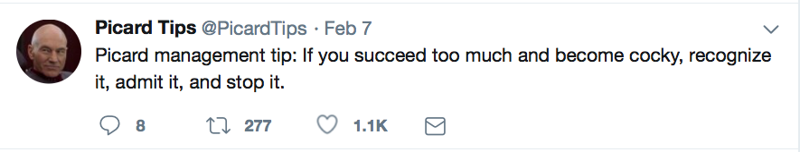

Slide 8
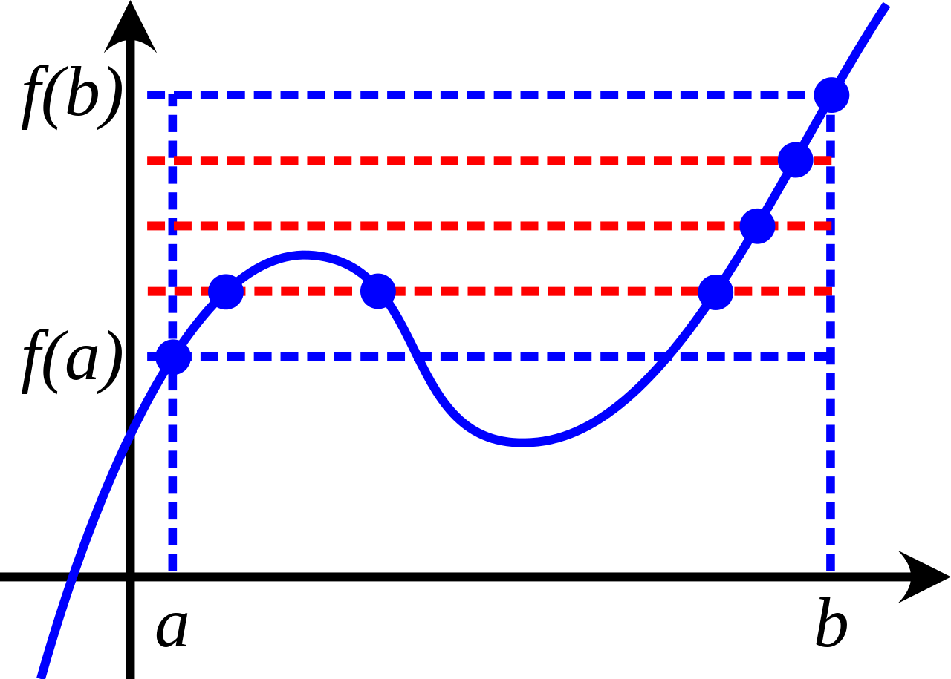
Intermediate to Advanced
We all know more about some things and less about others
We always wonder what we’re missing
New learning “sticks” better in the context of fundamentals
I hope this workshop will be a great close to the conference
But you’ll forget a lot by Monday
Link to materials at end of day
This Photo by Unknown Author is licensed under CC BY-SA

Slide 9
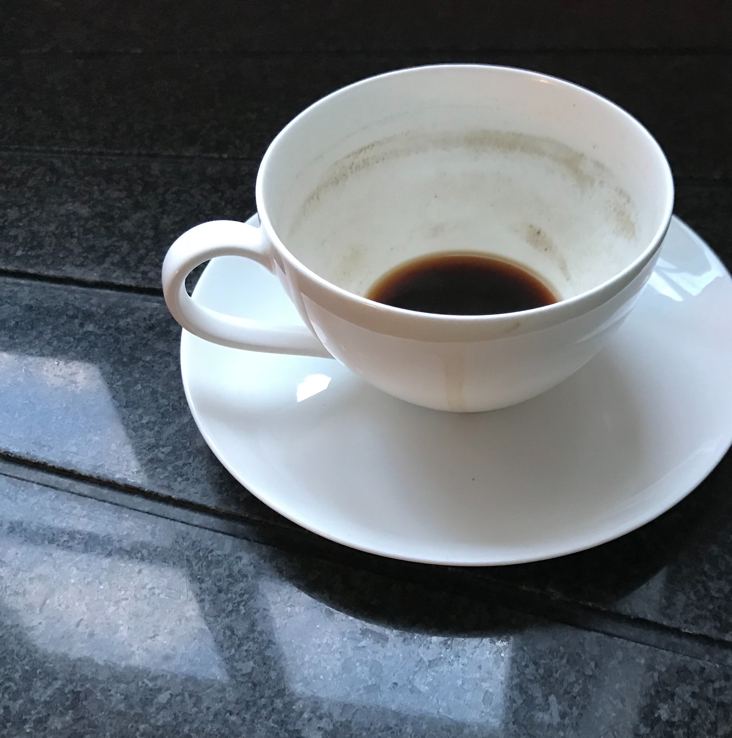
Break

Slide 10
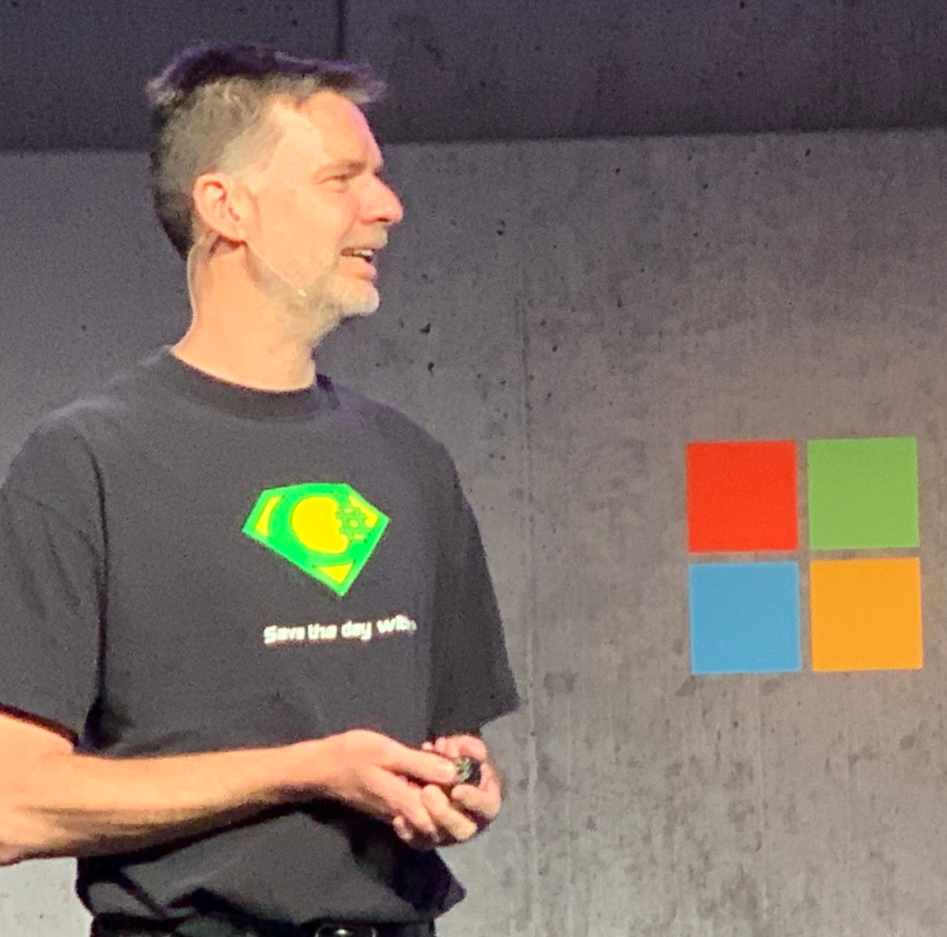
Special Guest

Slide 12
Break

Slide 13
DEMO
Puzzles!!

Slide 14

DEMO
Patterns!!

Slide 15
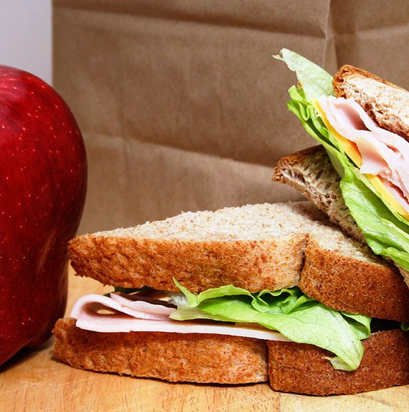
Lunch

Slide 16
DEMO
Puzzles!!

Slide 17

DEMO
Async!!

Slide 18
Break

Slide 19
Async – Avoid async void
Use this ONLY for event handlers
Information on any errors is swallowed
try catch
Either: recover or quit with logging
If you do nothing, or do nothing and crash the app with little info

Slide 20
Embrace the viral nature of async!
Do not using .Result or .Wait or variations
The task must be awaited by something useful
Desktop – message loop responsive to other requests
Web – ASP.NET can reuse the thread

Slide 21
Why use async?
Desktop
Responsiveness
UI does not appear frozen
User can press cancel
You can sometimes post progress
May need to disable inappropriate features
Web
Throughput
Return thread to ASP.NET
Requires state unload/reload
If the value is ready, process continues

Slide 22
CPU bound operations
Desktop
Use Task.Run
Maximize responsiveness
Get off the main thread
Web
DO NOT USE Task.Run
Maximize throughput
Avoid expensive thread switching
Exception to rule: Parallel calculations where latency is more important than throughput

Slide 23
ConfigureAwait(false)
Task normally switches to calling thread for continuation(*)
You can avoid this task switch with ConfigureAwait(false)
This has a minor performance improvement
Importance generally overstated
Do not use ConfigureAwait in library code!
It might be used by a desktop app, which will not continue correctly
(*) Continuation is code after await

Slide 24
Links to code
My GitHub repo has a bunch of junk and things that are half done. This will help you find what you want:
Puzzles: Look for the correct branches
https://github.com/KathleenDollard/sample-puzzles
Async breakfast is in this repo
Sample profiling problem:
https://github.com/KathleenDollard/sample-profiling-problem
If you mess with the numbers in Main, you can create a GC problem
My version of toll calculator – final branches for both workshop and session
https://github.com/KathleenDollard/sample-csharp-8
Use start-working if you want to do the walk through

Slide 25
Resources @KathleenDollard (in my repos, be sure you get the right branch!!!)
Summary.txt for our wrap up
Puzzles code on GitHub: https://github.com/KathleenDollard/sample-puzzles/tree/start-devintersection-2021
Pattern matching: https://github.com/KathleenDollard/sample-patterns/tree/devintersection-2021-start
Docs tutorial version of Toll Calculator
https://docs.microsoft.com/en-us/dotnet/csharp/tutorials/pattern-matching
Docs tutorial on arithmetic and other details (marked as beginner)
https://docs.microsoft.com/en-us/dotnet/csharp/

Slide 26

Summary

